Slide 1
Data Science Project
Kantha Kanchiraju

Slide 2
Problem of Feral Hogs
Feral Hogs are wild hogs
These are first introduced by Spanish explorers 300yrs ago
Their numbers kept on increasing
Around half the hog population is in Southern states. Texas has the most.
Damage caused by Hogs is estimated to be $1.5bil annually in US.
Damages are like rooting pastures and rangeland, consumption of native vegetation, negative effects on water quality, and predation of wildlife

Slide 3
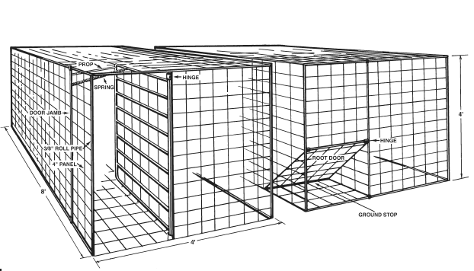
Traps

Slide 4
Solution
Use of Camera and image recognition for triggering the trap
Tagged images are used for training a Neural Network model.
This model is fed with images from the camera for detecting Hogs
Once Hogs are detected trap door will get closed

Slide 5
YOLO Real time Object Detection
YOLO (You only Look Once)
A single neural network to the full image
This network divides the image into regions and predicts bounding boxes and probabilities for each region
These bounding boxes are weighted by the predicted probabilities.

Slide 6
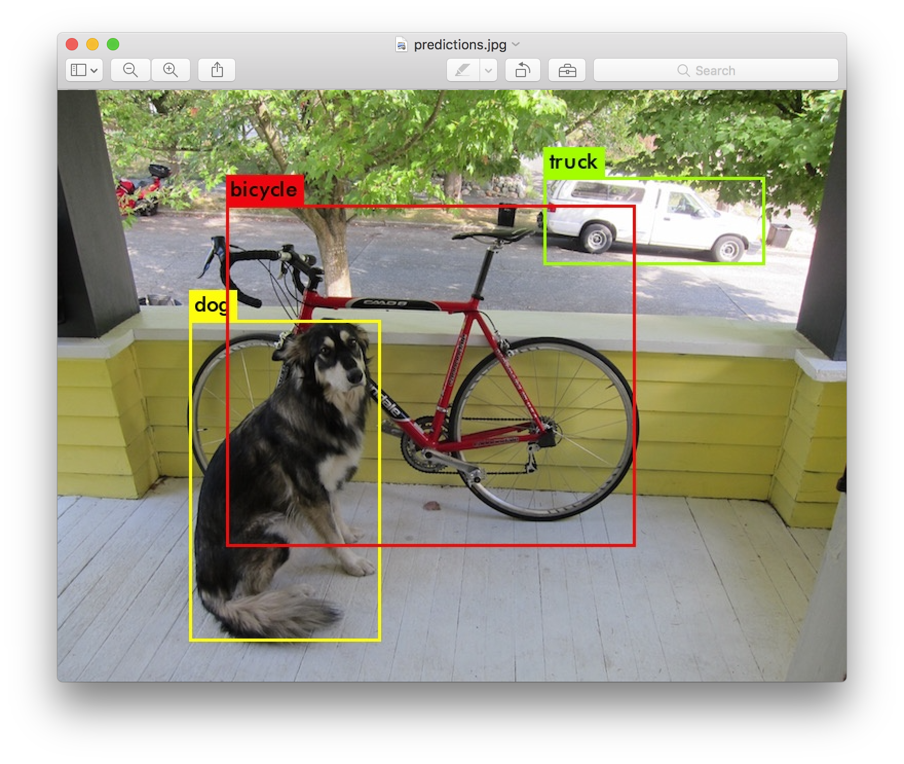
YOLO Predictions

Slide 7
Prototype Custom Vision API by Azure
I have used Custom Vision API provided by Azure
I got the images from the Google and Manually tagged them
Used these tagged images for training the Model
Used the Prediction end point for feeding images and detecting objects
https://www.customvision.ai/projects
https://colab.research.google.com/drive/1mN96ySFiUC0IB3ji0i24tUN1mvcsvBsR

Slide 8
References
https://mdc.mo.gov/wildlife/nuisance-problem-species/invasive-species/feral-hogs-missouri
https://tpwd.texas.gov/huntwild/wild/nuisance/feral_hogs/

